Slide 1
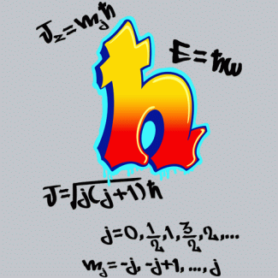
Physics Introduction
Mr. Conlon
KAS Prep
2011-2012

Slide 2
Introduction
All matter has mass and occupies spaces. The amount of mass an object has is related to the amount of matter an object has.
Matter has four forms:
Solid
Liquid
Gas
Plasma
The quantity of space which a body occupies is called its volume.
Energy is the ability to do work
Energy comes in multiple forms, some of which are:
Magnetism
Electrical Energy
Heat
Light
Sound
Nuclear Energy
The weight of a body is the force with which the gravitational pull of the Earth attracts.

Slide 3
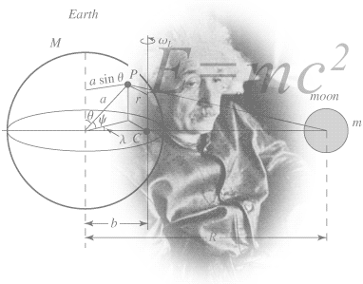
Introduction Cont’d
The standard units of measurement are:
Length – meter (m)
Mass – kilogram (kg)
Time – second (s)
Electric Current – ampere (A)
Temperature – Kelvin (K)
Area of basic shapes:
Square = s²
Rectangle = l x w (length x width)
Triangle = ½bh
Circle = πr²
Volume of basic shapes:
Square = s³
Rectangle = l x w x h (length x width x height)
Triangular Prism = ½bhl
Sphere = ⁴/₃πr³

Slide 4
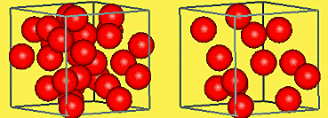
Density
To calculate density:
Example:
If a sample of metal is found to have a mass of 210 grams and a volume of 20.0 cubic centimeters, the density of the metal is:

Slide 5
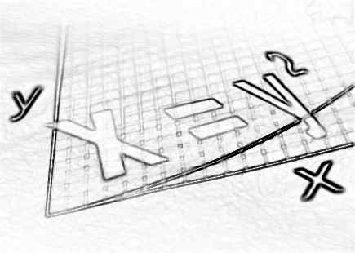
Unit Combination
In physics you see that as you perform algebraic operations, units must follow the same operations. For units a and b will make combinations as follows:

Slide 6
Unit Combinations Cont’d
Consider the following examples:
The volume of a box whose dimensions are 3 meters by 2 meters by 1 meter would be calculated as:
Again, In computing the mass of a body whose volume is 2 cm³ and whose density is 8 g/cm³, we have

