Slide 1
Scientific Notation
Mr. Conlon
KAS Prep
2011-2012

Slide 2
Introduction
Power | 10³ | 10² | 10¹ | 10⁰ | 10⁻¹ | 10⁻² | 10⁻³
Value | 1000 | 100 | 10 | 1
Each time you divide by 10, the exponent decreases by 1 and the decimal point moves one place to the left.
Each time you multiply by 10, the exponent increases by 1 and the decimal point moves one place to the right.

Slide 3
Evaluating Powers of 10
Words | Numbers
Positive Integer Exponents If n is a positive integer, find the value of 10^{n} by starting with 1 and moving the decimal point n places to the right | 10⁴ = 10,000
Negative Integer Exponents If n is a positive integer, find the value of 10^{-n} by starting with 1 and moving the decimal point n places to the left.

Slide 4
Practice

Slide 5
Writing Powers of 10
10,000,000 The decimal point is seven places to the right of 1, so the exponent is 7. 10⁷ | 0.001 The decimal point is three places to the left of 1, so the exponent is -3. 10⁻³ | 10 The decimal point is one place to the right of 1, so the exponent is 1. 10¹
100,000,000 | 0.0002 | 0.1

Slide 6
Multiplying by Powers of 10
If the exponent is a positive integer, move the decimal to the right
If the exponent is a negative integer, move the decimal to the left
97.86x10⁶ | 19.5x10⁻⁴ | 853.4x10⁵ | 0.163x10⁻²

Slide 7
Scientific Notation
Scientific notation is a method of writing numbers that are very large or very small. A number written in scientific notation has two parts that are multiplied. The first part is a number that is greater than 1 and less than ten. And the second part is a power of 10.
3.5x10¹¹

Slide 8
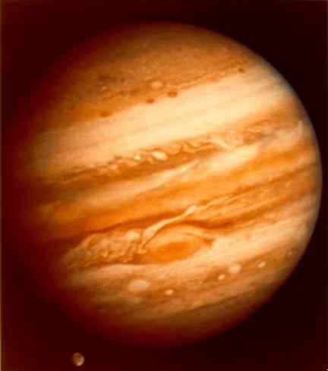
Example
Jupiter has a diameter of about 143,000 km. Its shortest distance from Earth is about 5.91x10⁸ km, and its average distance from the Sun is about 778,400,000 km. Jupiter’s orbital speed is approximately 1.3x10⁴ m/s.
Write Jupiter’s shortest distance from Earth in standard form.
Write Jupiter’s average distance from the Sun in scientific notation.

